Slide 1
FS 13, Polder 35/3 7 March 2023
Flap gate open,
Not by steel rope but local rope,

Slide 2
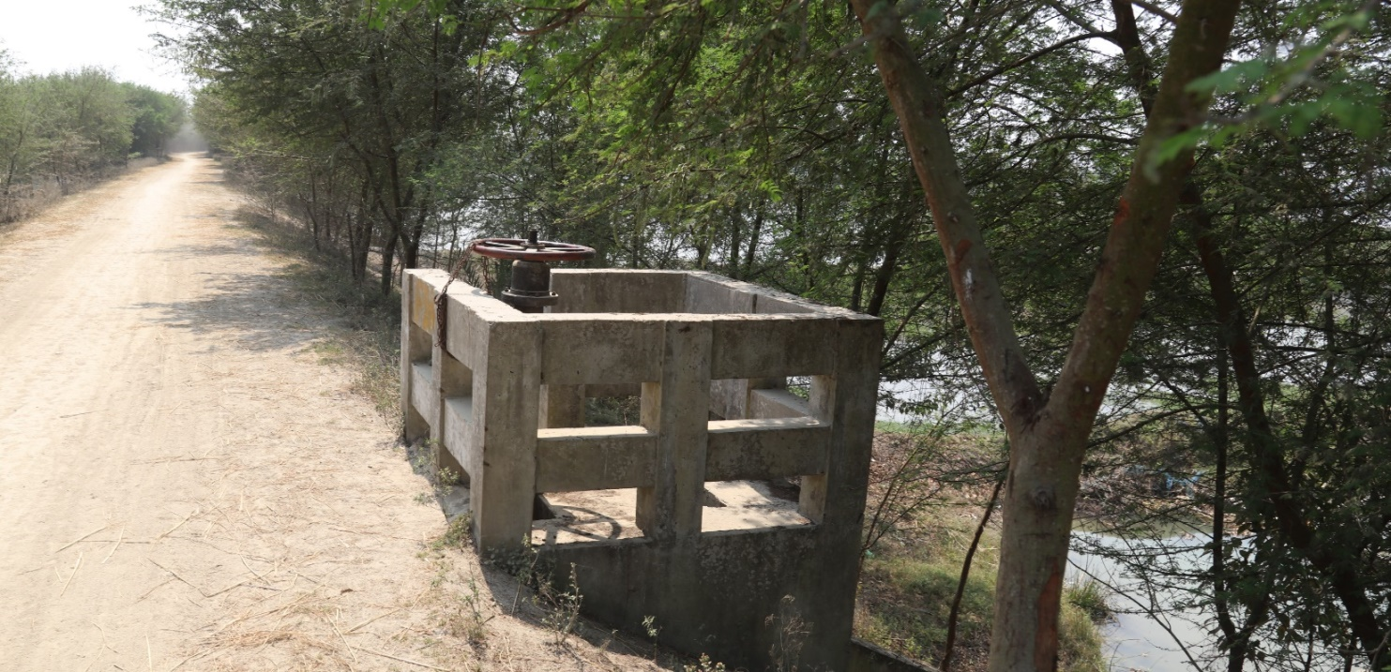
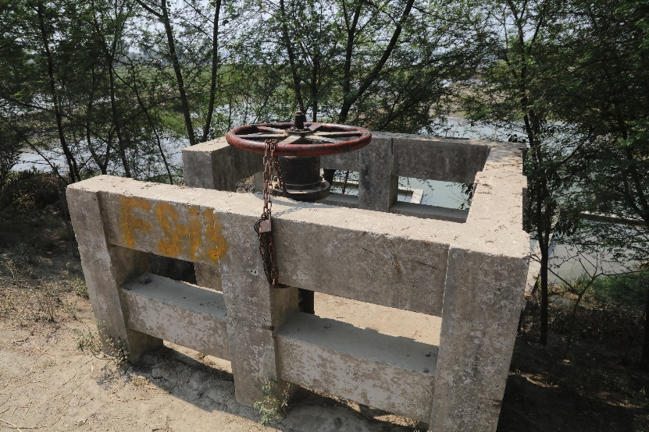
Overview

Slide 3
Country Side Slope Protection

Slide 4
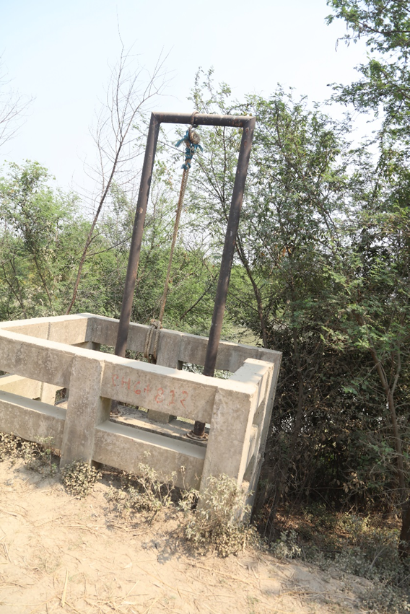
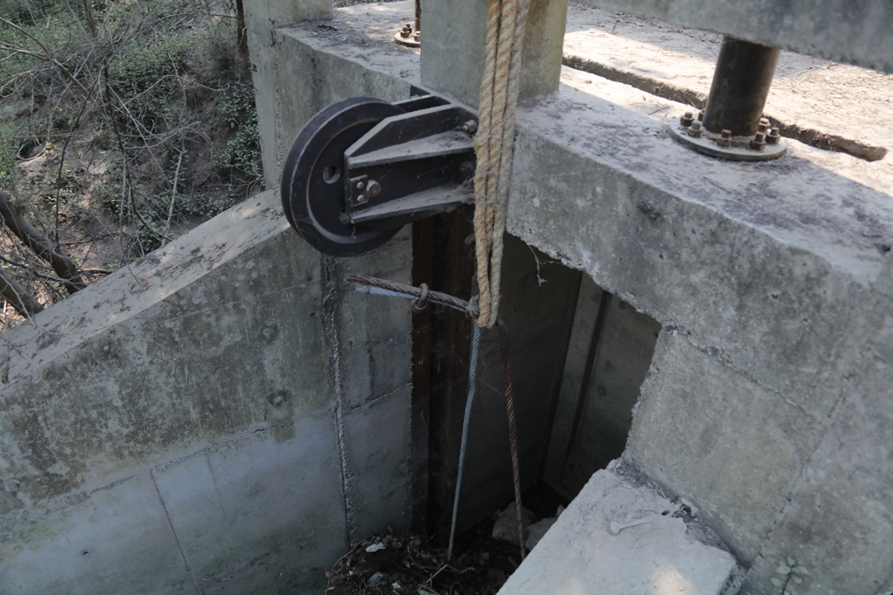
Riverside Flap Gate

Slide 5
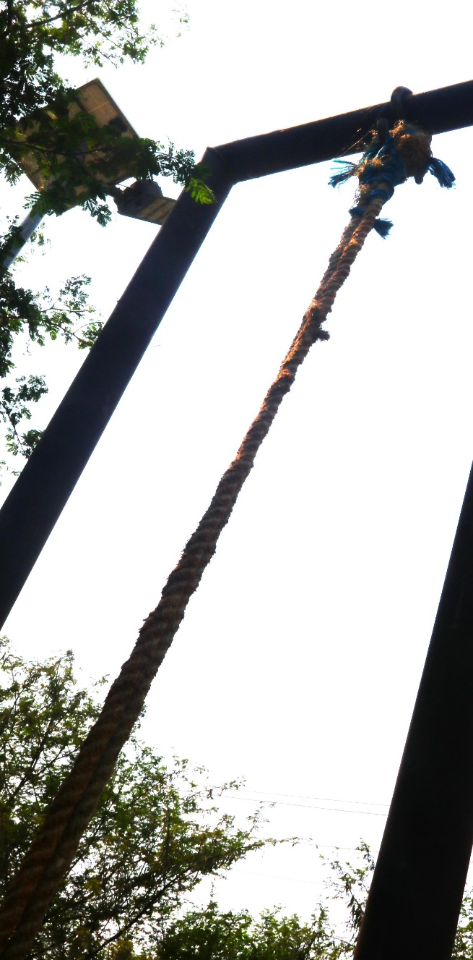
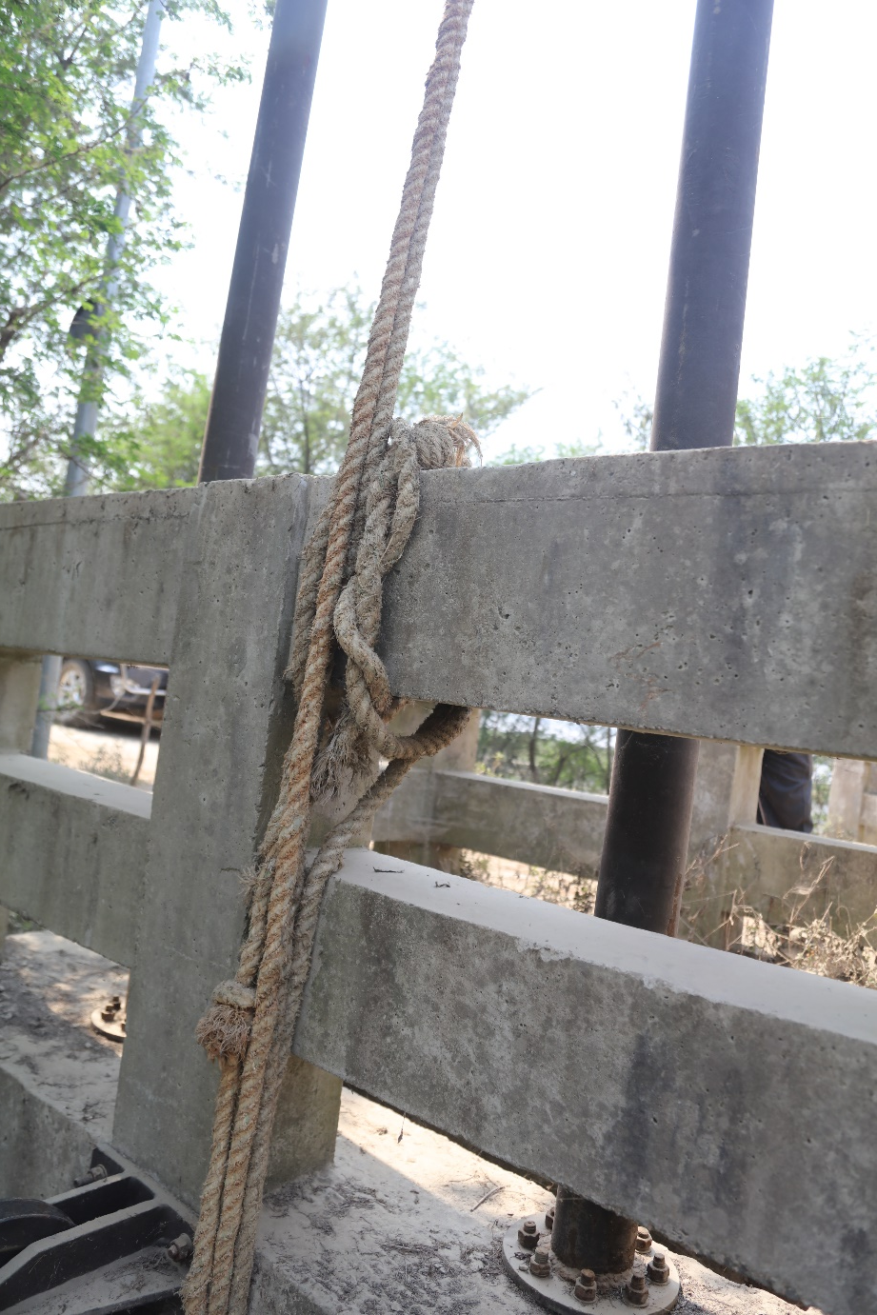

Slide 6
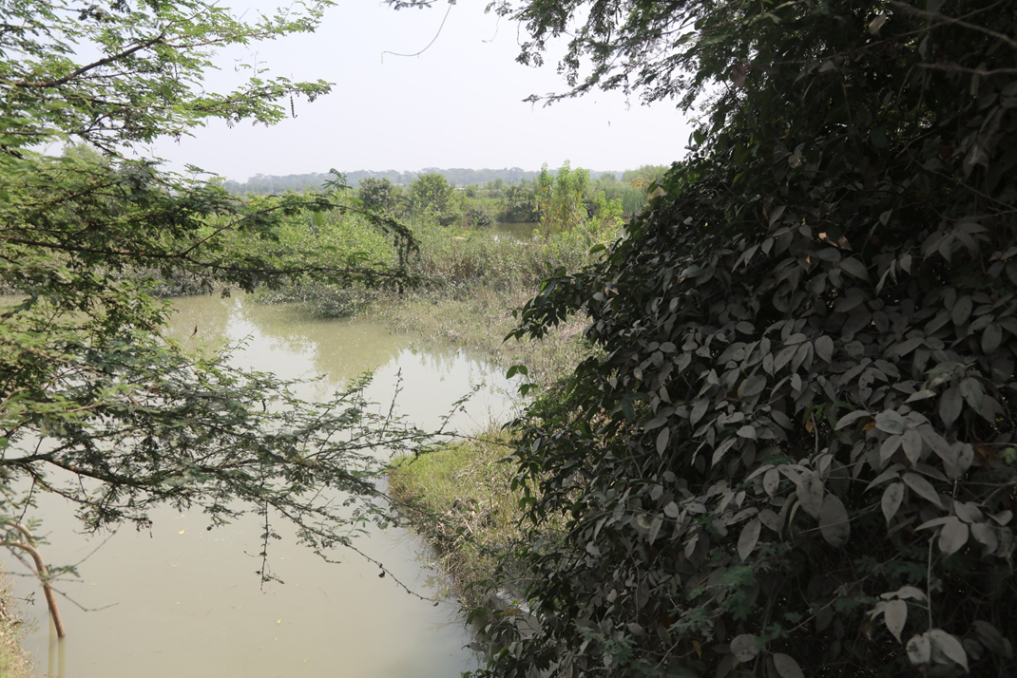
River side

